Slide 1
Entitlement Lifecycle
Draft
Renew
Waiting
Start Date not reached
Renew
Cancelled
Active
Expired

Slide 2
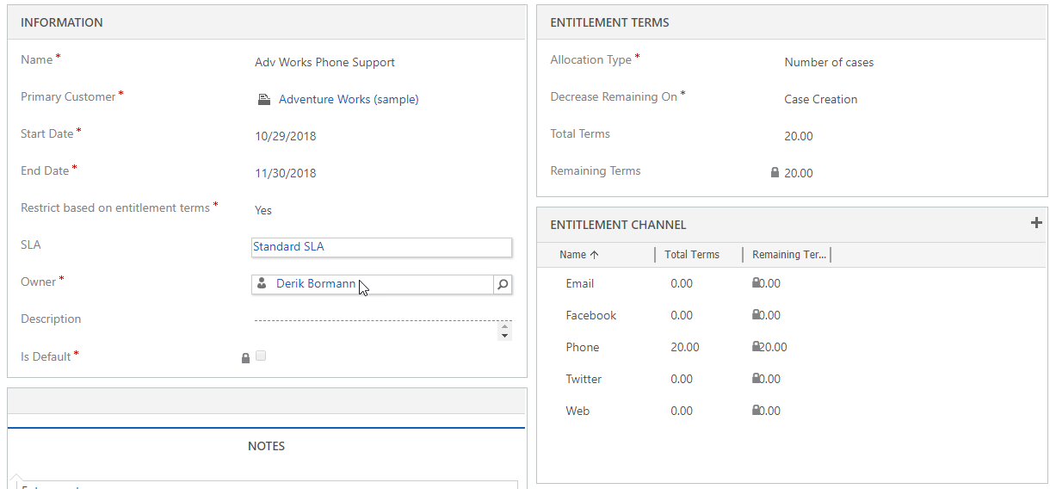

Slide 3
What’s the Difference?
Multi
Channel
Omni
Channel
VS
Notes:
Multi Channel:
Offers two or more channel Experiences
Channel Experience is not Consistent
Example: Support started via Chat – When transferred to an agent you have to provide all of your information again.
Omni Channel
Customer Experience across channels is consistent
Context is used to streamline across apps

Slide 4





Entitlement-based channel switching
Increase revenue and
customer satisfaction
Premium Service
Low value
Product
High value
Product
Self Service with
Assist Mode
Self Service Only
Decrease Cost and
stabilize customer satisfaction

Slide 5
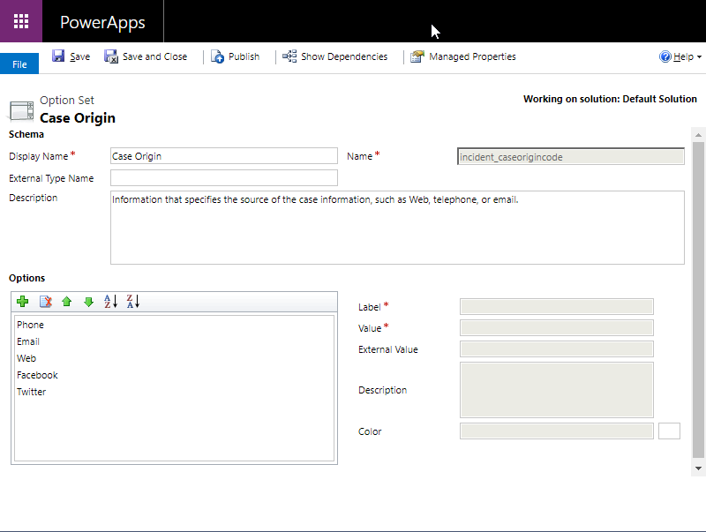

Slide 6
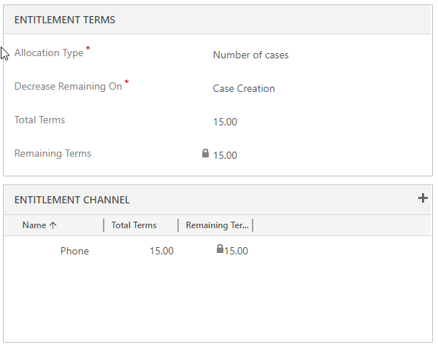

Slide 7
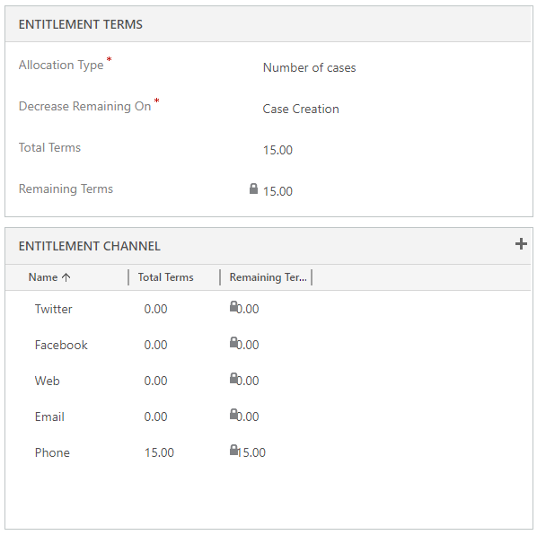

Slide 8
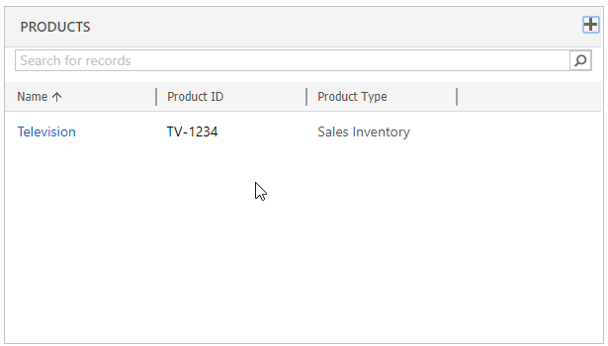
Multiple products can be added to a single entitlement.

Slide 9
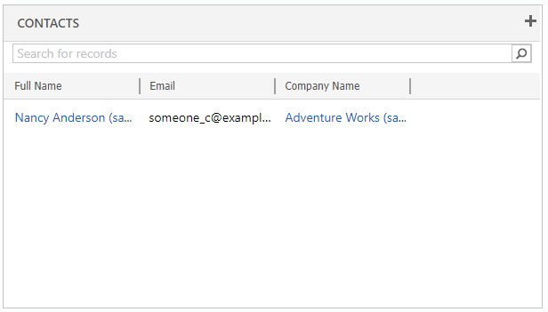
Multiple contacts can be added to a single entitlement.

Slide 10
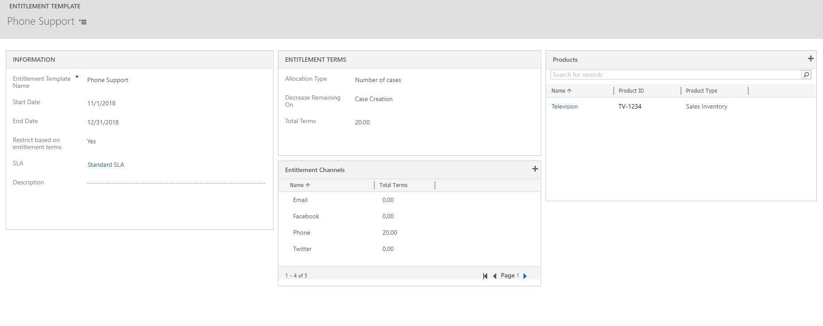
Start & End dates can be over-written.
Both Products & Entitlement Channels can be defined.
Contacts cannot be defined.
Start & End dates can be over-written.

